Slide 1
Term Project Junye Zhu
Goal:
Extract time expressions
Normalize extracted time expressions
Platform:
C++
Method:
Dictionary matching
During day
General time
Holiday
Month
Number
Order
weekday

Slide 2
Process
1. load dictionary ,input and input date
2. separate sentences into phrases according to the ‘,’ ‘.’ ‘?’ ‘\n’
3. to every phrase, get token(word),match ,‘on’ ‘ in’ ‘at’ month.list, number.list, ‘this’ ‘that’ ‘last’ ‘next’ ‘today’ ‘yesterday’ ‘tomorrow’
4. if get a match, determine the next token using different patterns. For example, after ‘on’, find weekday, holiday, month, numbers. Then we get a time expression
5. calculate the time expression
To specific date, just output the date
To a duration time( like two months ago), calculate the range.get the result date according to input date and range

Slide 3
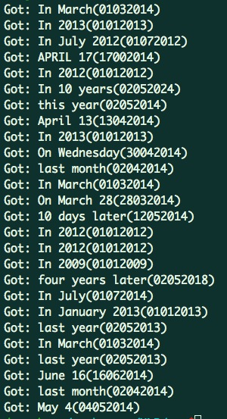
Result
Using an article on New York Times, May 4th 2014
Deviation
For example:
‘Through April 13, officers seized roughly 1,700 glassine bags of heroin, up from about 1,200 bags over the same period in 2013. ’
Got: April 13(13042014)
Got: In 2013(01012013)
‘APRIL 17, 2014’
Got: APRIL 17(17042014)

